Slide 1
Monday Warm-Up August 29, 2016
8-29-16
Name one important part of a textbook.
Week #2: August 29-September 2 or 8-29-16 to 9-2-16
Quote of the week: A #2 pencil and a dream can take you anywhere.

Slide 2
What will I learn today?
Know
Do
glossary
table of contents
units
chapters
identify the different parts of the textbook through the completion of a textbook scavenger hunt

Slide 3
Time to get cozy!
It is now your turn to uncover the parts of your textbook for the year.
Your textbook number is the same as your desk number
You will have 25 minutes to complete the textbook scavenger hunt

Slide 4
Exit Ticket
Complete at the end of your scavenger hunt:
  How do the units, chapters and sections go with each other?

Slide 5
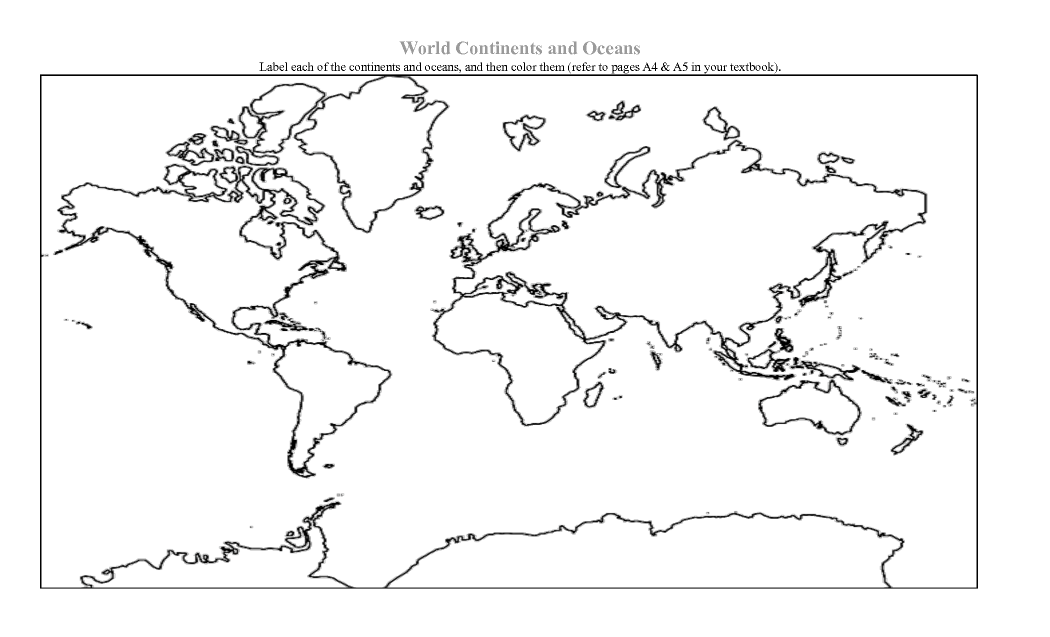
2
1
3

Slide 6
What to bring to class tomorrow…
Spiral Notebook
Parent Information Sheet

Slide 7
Tuesday Warm-Up August 30, 2016
8-30-16
What characteristics do you think about when deciding where someone is from?
Know | Do
Continent characteristics | identify the characteristics of the different continents by placing photos where the students think the people are from.

Slide 8
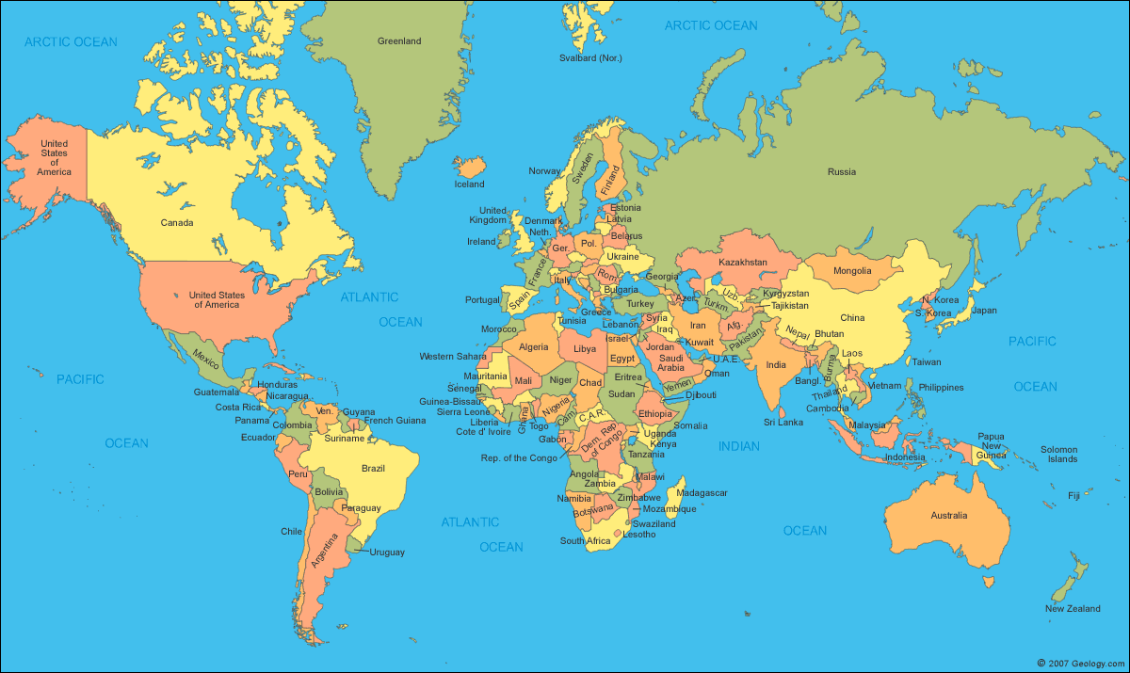
Review of the World

Slide 9
Map Activity

Slide 10
Wednesday Warm Up 8/31
Warm up question: Why is it important to be organized?
Quote of the week: A #2 pencil and a dream can take you anywhere.

Slide 11
What will I learn today?
Know
Do
Geography
Country
Continent
Region
Landform
Identify the major characteristics of geography

Slide 12
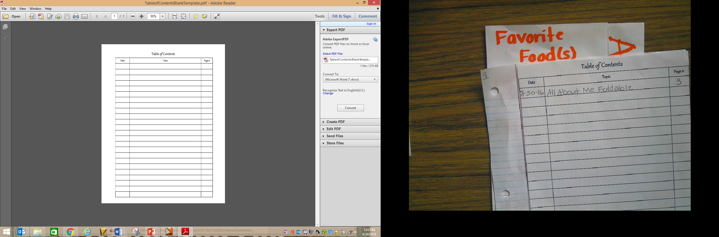
Add to your table of contents…
8-30-16
All About Me foldable
3
8-31-16
Geography Vocabulary
4
8-31-16
Geography Introduction Notes
4

Slide 13
“Thinking Like a Geographer”
Chapter 1 Section 1

Slide 14

Taking notes
While we go through the power point, copy anything that is glowing
Raise your hand if you need more time.
Take good notes and study your vocab!
We will have a quiz on Friday, September 9, 2016

Slide 15
What is Geography?
Geography – the study of the earth in all its variety.
Two types of Geography:
  1. Physical Geography
  2. Human Geography

Slide 16

Geographers often ask these questions:
“Where is this place located?”
“What is this place like?”
“How is these two places different?”

Slide 17
What is a Landform?
Landforms – individual features of the land.
Examples: Mountains, valleys, oceans, rivers

Slide 18
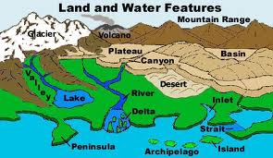

Slide 19
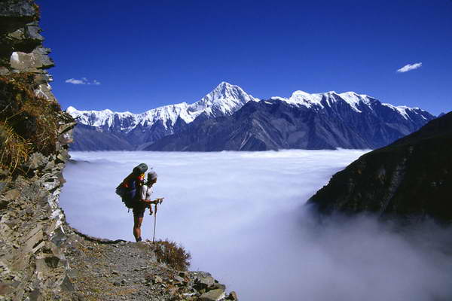
Mt. Everest Tallest Mountain in the World

Slide 20
People and Places
Geographers are interested in how people interact with their environment –natural surroundings.
How does where you live influence how you live?

Slide 21
Big or Small
A region – place that shares common characteristics.
Regions can be…..

Slide 22
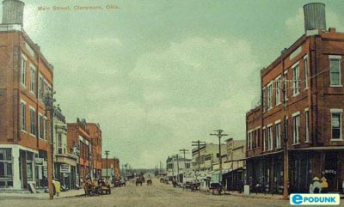
Small like Claremore, Oklahoma

Slide 23
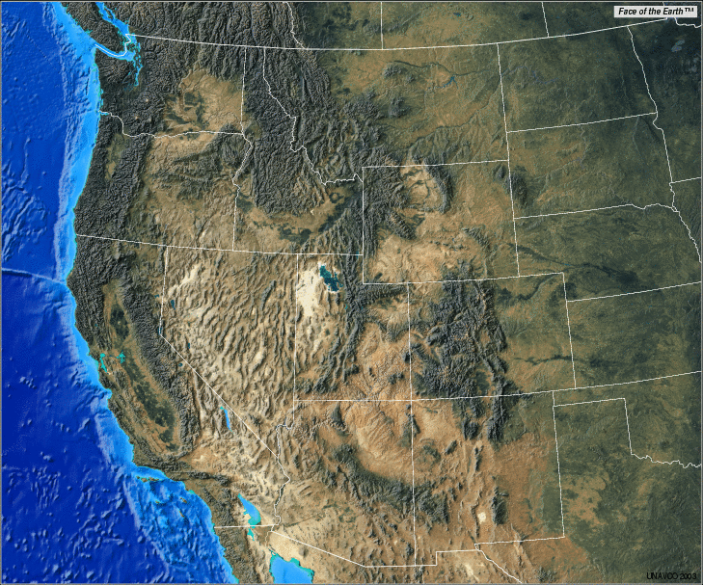
Or Big like The Western United States of America

Slide 24
Thursday Warm Up September 1, 2016
9/1/16
Warm up question: What is a continent? Give one example.
Quote of the week: A #2 pencil and a dream can take you anywhere.
Know | Do
Geography Country Continent Region Landform Ocean World | describe where you live by using basic geography vocabulary

Slide 25
Add to your table of contents…
8-30-16
All About Me foldable
3
8-31-16
Geography Vocabulary
4
8-31-16
Geography Introduction Notes
5
9-1-16
Continents, GPS, GIS, and the Past

Slide 26
Country vs. Continent
A continent is one of the earth’s large piece of land
  The continent you live on is North America
A country is a nation with its own government in one area
  The country we live in is the United States of America

Slide 27
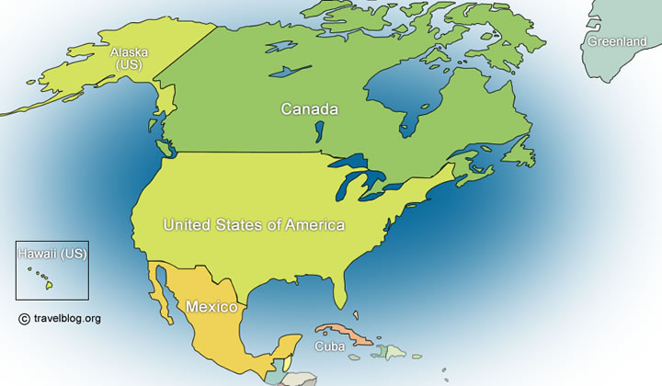
A continent is made up of countries.

Slide 28
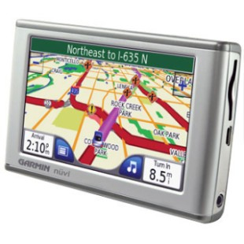
Global Positioning System (GPS)
What is a GPS?
What does it do?
GPS – a receiver that gets a signal from satellites and tells your exact location

Slide 29
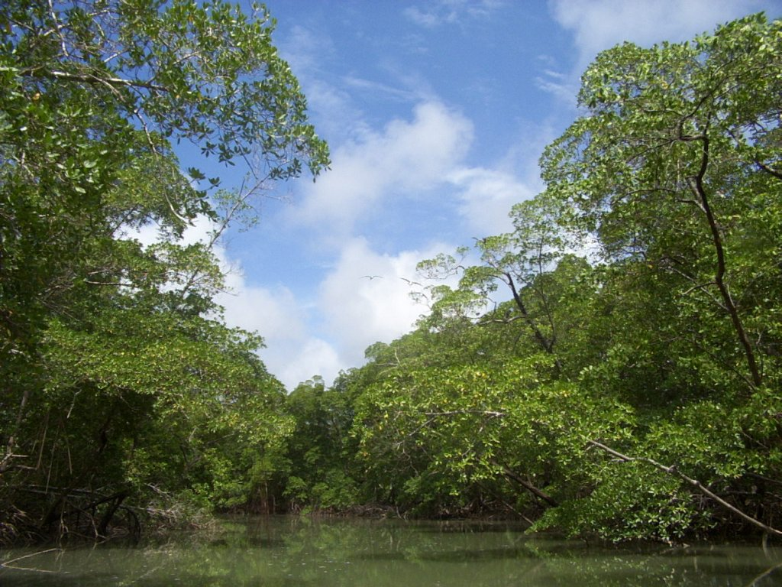
Geographic Information Systems
GIS – computer software that helps geographers gather many different kinds of information about the same place.
It was developed in the early 2000’s to help conserve the plants and animals in the Amazon rain forest.

Slide 30
What about the Past?
Geography can be used to discover the past.
Archaeologists and Anthropologists dig up artifacts – tools, pottery, paintings, and other items.
They also study fossils – remains of humans
All are used to figure out how people used to live

Slide 31
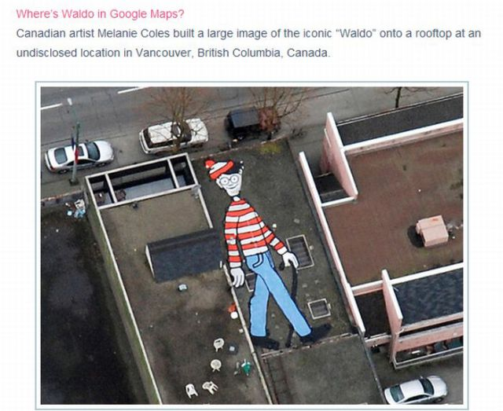

Slide 32
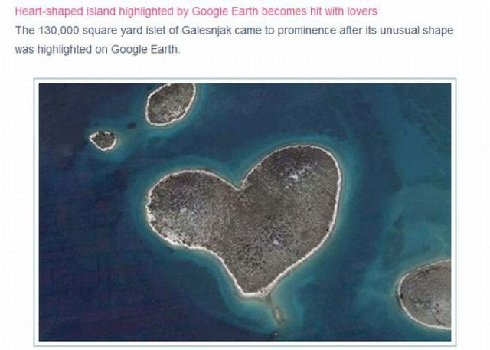

Slide 33
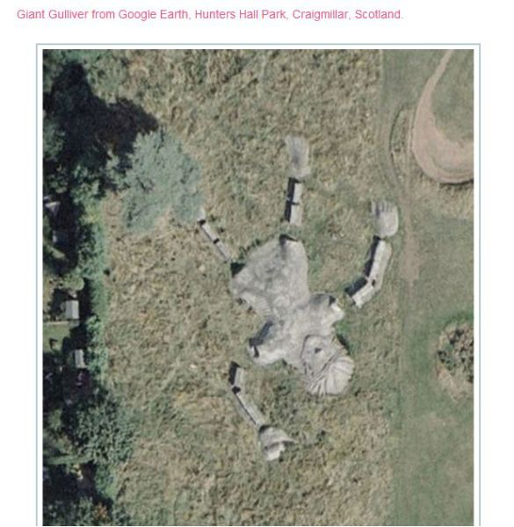

Slide 34
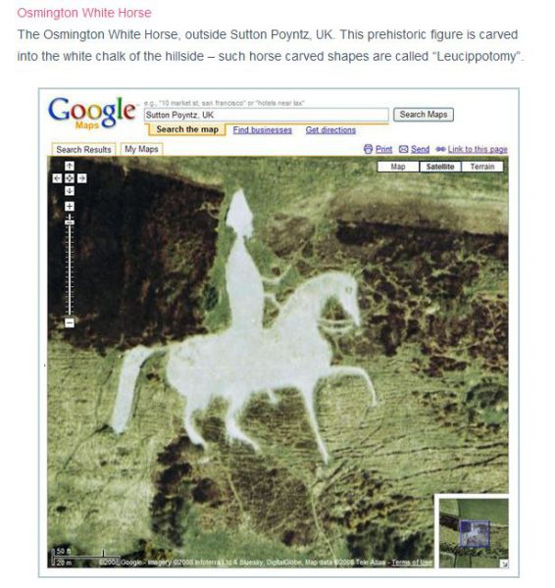

Slide 35
Learning Check
Describe where you live using the following sentence starters
  Region: The region I live in the Eastern Shore of Maryland, Mid-Atlantic Region, the East Coast of the United States of America
  Continent: The continent I live on is North America
  Country: The country I live in is the United States of America (USA)
  Landform: I live near the landform Chesapeake Bay, Choptank River, Atlantic Ocean, Delmarva Peninsula

Slide 36
Friday Warm Up September 2, 2016
9/2/16
Know | Do
Continent Ocean World Intermediate Directions Cardinal Directions Compass rose | Explain the location of the continents and oceans by labeling a blank political world map and explain the directions by labeling a compass rose
Warm up question:
1.How many oceans are there in the world?
2. How many continents did Pangea break into?
Quote of the week: A #2 pencil and a dream can take you anywhere.

Slide 37
Add to your table of contents…
8-30-16
All About Me foldable
3
8-31-16
Geography Vocabulary
4
8-31-16
Geography Introduction Notes
5
9-1-16
Continents, GPS, GIS, and the Past
9-2-16
Continents, Oceans, and Compass Rose

Slide 38
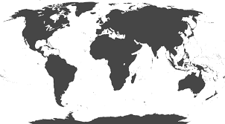
Label the Map
Your group will be given a blank map.
As a group, label the map where you think things belong with the sticky notes, using the word bank that is displayed on the board.
You must label all of the following things:
  The continents
  The oceans
Use your word banks to help you out!
Don’t worry about right and wrong. Just try your best so I see what you already know!

Slide 39
Word Bank
South America
Australia
Africa
Asia
North America
Europe
Indian Ocean
Atlantic Ocean
Southern Ocean
Artic Ocean
Pacific Ocean

Slide 40
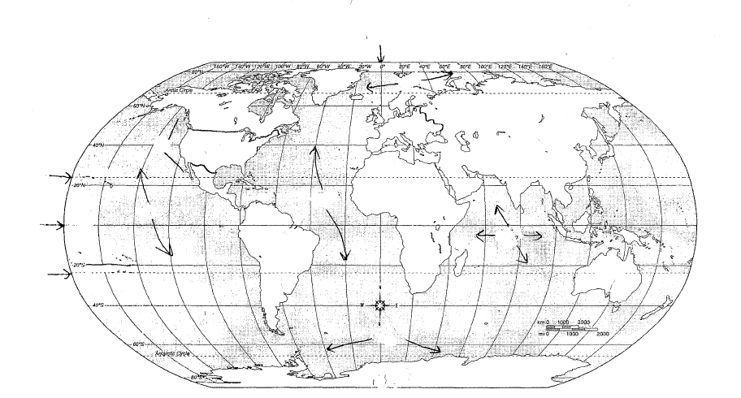

Slide 41
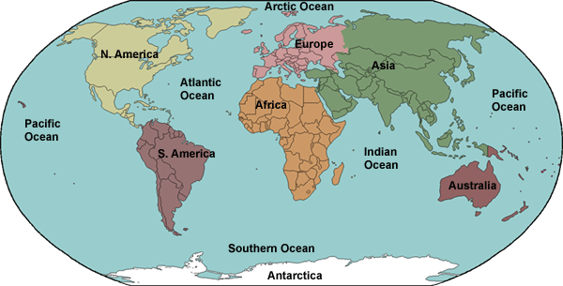
How did we do?

Slide 42
The Continents
The Oceans
North America
South America
Antarctica
Africa
Asia
Australia
Europe
Atlantic
Pacific
Arctic
Indian
Southern

Slide 43
How can we remember??
S
A
A
A
A
N
E
P
A
A
I
S

Slide 44
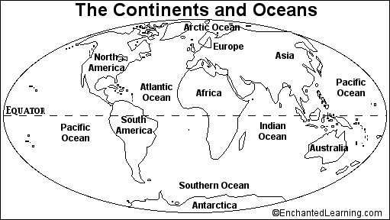
Fill in your own map for your notebook

Slide 45
Learning Check– Identify numbers 1-3
2
1
3

Slide 46

Tuesday Warm Up September 6, 2016
9/6/16
Warm up question:
1.Identify #1 and #2
1
2
Week # 3: September 5-9, 2016
Quote of the week: Successful people never worry about what others are doing

Slide 47
What will I learn today?
Know
Do
Legend
Scale
Compass rose
Intermediate directions
Cardinal directions
Describe objects on a map by using the parts of a map as well as describe a place they know by creating a map of that place.

Slide 48
Add to your table of contents…
8-30-16
All About Me foldable
3
8-31-16
Geography Vocabulary
4
8-31-16
Geography Introduction Notes
5
9-1-16
Continents, GPS, GIS, and the Past
9-2-16
Continents, Oceans, and Compass Rose
9-6-16
Equator, Prime Meridian, Parts of a map

Slide 49

Lost? Use Directions!
Directions on a map – use the compass rose
Cardinal Directions:
North
South
East
West
Intermediate Directions:
Northeast
Southeast
Northwest
Southwest

Slide 50
NORTH
NORTH is the direction at the top of the compass rose.

Slide 51
SOUTH is the direction at the bottom of the compass rose.
SOUTH

Slide 52
EAST
EAST is the direction to the right on the compass rose.

Slide 53
WEST
WEST is the direction to the left on the compass rose.

Slide 54
Intermediate Directions
Northwest
Northeast
Southwest
Southeast

Slide 55
Exit Ticket: Label the missing parts.
C
A
B

Slide 56
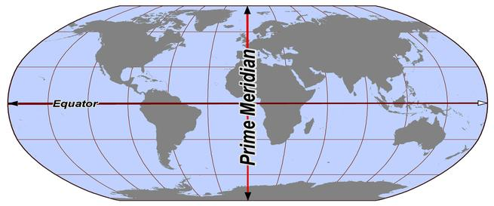
The equator is an invisible line that cuts the earth in half from side to side
  Located at 0 degrees latitude
The prime meridian is an invisible line that cuts the earth in half from top to bottom
  Located at 0 degrees longitude

Slide 58
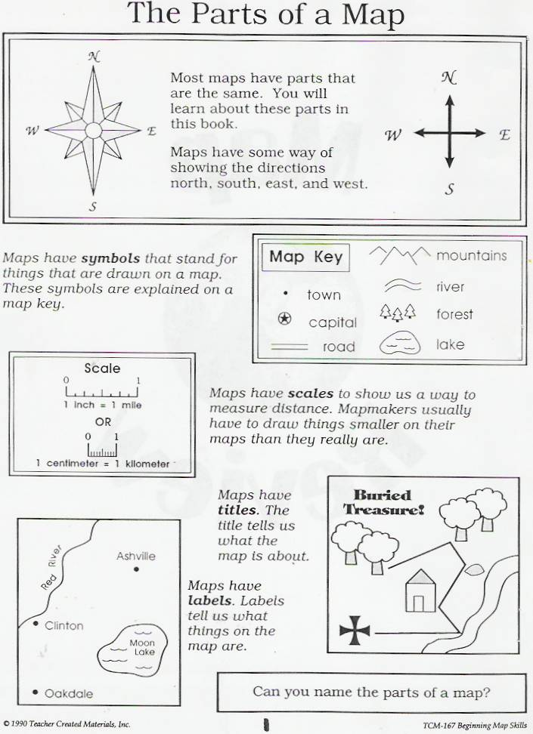
Parts of a map
The compass rose

Slide 59
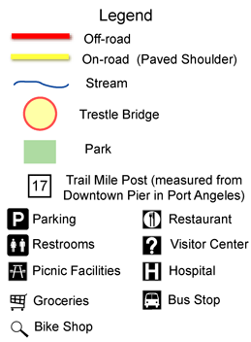

Slide 60
Maps have legends to explain the symbols.

Slide 62
Plickers review!
Get your plickers ready to answer some questions and read some maps!

Slide 63
Create a map
Think of a place you know very well.
It could be your bedroom, this classroom, your kitchen,….
Create a map of this place.
It must include the following:
  A title describing what the map is of.
  Symbols within the map
  A legend describing the symbols
  A scale to show how big or small spaces are
  A compass rose

Slide 64
Homework
Finish your map for homework due tomorrow!
We still have a quiz tomorrow on geography skills and vocabulary!

Slide 65
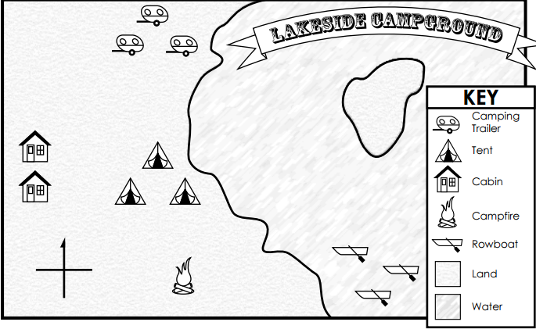
Exit Ticket
According to the map, how many camping trailers are there?

Slide 66
Wednesday Warm Up September 7, 2016
9/7/16
Warm up question: Pick 2 and define them:
Scale
Compass rose
Legend
Symbol
Geography
Week # 3: September 5-9, 2016
Quote of the week: Successful people never worry about what others are doing

Slide 67
What will I learn today?
Know
Do
Legend
Scale
Compass rose
Thematic map
Topographic map
Political map
Physical map
Population density map
Navigational map
Relief map
Describe a place by creating a map of it using the major parts of a maps, as well as explain the different types of map by determining the type of map being displayed.

Slide 68
Create a map (Periods 1,3, and 6)
Think of a place you know very well.
It could be your bedroom, this classroom, your kitchen,….
Create a map of this place.
It must include the following:
  A title describing what the map is of.
  Symbols within the map
  A legend describing the symbols
  A scale to show how big or small spaces are
  A compass rose

Slide 69
Add to your table of contents…
8-30-16
All About Me foldable
3
8-31-16
Geography Vocabulary
4
8-31-16
Geography Introduction Notes
5
9-1-16
Continents, GPS, GIS, and the Past
9-2-16
Continents, Oceans, and Compass Rose
9-6-16
Equator, Prime Meridian, Parts of a map
9-7-16
Types of Maps

Slide 70
Types of Maps

Slide 71
Types of maps
There are 7 types of maps:
  Political map
  Physical map
  Topographical map
  Relief map
  Navigational map
  Population density map
  Thematic map

Slide 72
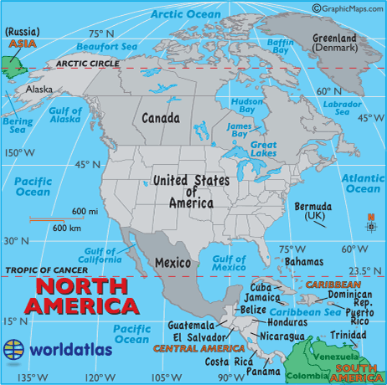
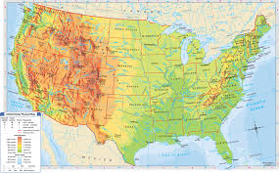
Political vs. Physical
Political Map
Physical Map
Show the boundaries between countries
Shows the landforms of an area

Slide 73
Thursday Warm-Up 9/8/16
What is the difference between political and physical maps?
Know | Do
Legend Scale Compass rose Types of Maps Continent Ocean Geography Equator Prime Meridian Cardinal directions Intermediate directions | Summarize your knowledge of continents, oceans, parts of a map, and basic geography vocabulary by reviewing with plickers for a quiz
Week # 3: September 5-9, 2016
Quote of the week: Successful people never worry about what others are doing

Slide 74
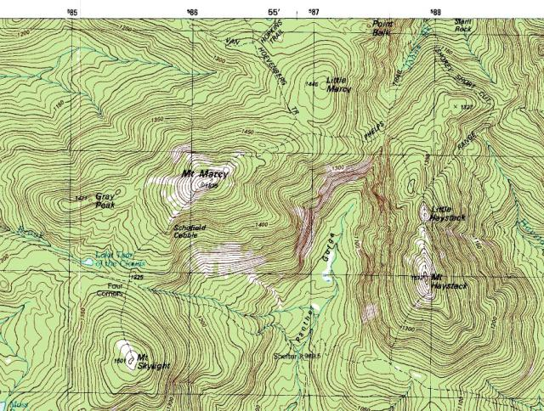
Topographical map
Shows natural and man-made features

Slide 75
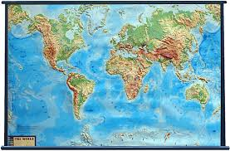
Relief Map
Shows the height and depth of mountains, valleys, hills, etc.

Slide 76
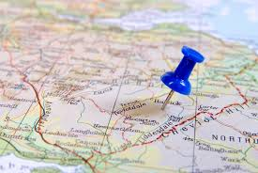
Navigational Map
Road Map
Shows:
  Visitor centers
  Routes/Road names

Slide 77
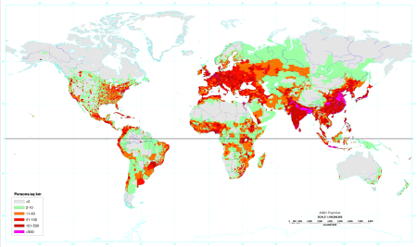
Population Density Map
Shows the population of cities/towns for a certain area.

Slide 78
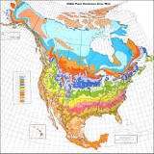
Thematic Map
Shows one particular theme of an area
Examples:
  Natural resources
  Land uses
  Locations of religions

Slide 79
Quick review!
Get out your plickers!
Quick review before our quiz!

Slide 80
Friday, September 9, 2016
Know | Do
Legend Scale Compass rose Types of Maps Continent Ocean Geography Equator Prime Meridian Cardinal directions Intermediate directions | Summarize your knowledge of continents, oceans, parts of a map, and basic geography vocabulary in order to complete a quiz.
Pick 2 and define
  Prime Meridian
  Equator
  Cardinal Directions
  Intermediate Directions

Slide 81
Quiz Procedures
Stay absolutely silent – no noise, no talking, no sound!
Eyes on your own paper!
If you have a question or need to leave your seat, raise your hand.
When you finish, turn it in up front in the basket with your period number on it. Work on your map if you have not finished it.
Talking or cheating = ZERO FOR A GRADE!

Slide 82
Word Bank
Indian Ocean
Atlantic Ocean
Southern Ocean
Artic Ocean
Pacific Ocean
South America
Australia
Africa
Asia
North America
Europe
Antarctica
Extra Credit Question: If you start in North America and go to the continent directly south of it, then east one continent, north one continent and east 1 continent.
Where will you be?

Slide 83
Exit ticket
List one thing you did well on the quiz.
List one thing you still don’t understand.

